Slide 1
Lecture 22 Significance Level, Critical Value, and Making Decisions

Slide 2
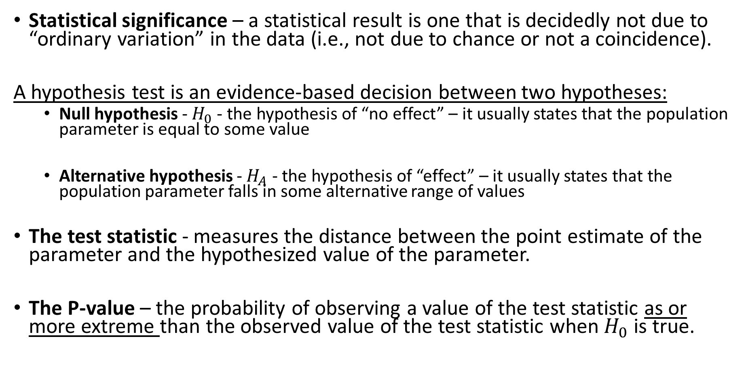
Review From Monday
Statistical significance – a statistical result is one that is decidedly not due to “ordinary variation” in the data (i.e., not due to chance or not a coincidence).
A hypothesis test is an evidence-based decision between two hypotheses:
Null hypothesis - $H_{0}$ - the hypothesis of “no effect” – it usually states that the population parameter is equal to some value
Alternative hypothesis - $H_{A}$ - the hypothesis of “effect” – it usually states that the population parameter falls in some alternative range of values
The test statistic - measures the distance between the point estimate of the parameter and the hypothesized value of the parameter.
The P-value – the probability of observing a value of the test statistic as or more extreme than the observed value of the test statistic when $H_{0}$ is true.

Slide 3
Review: The five steps of a hypothesis test
1. Assumptions
2. State the null and alternative hypotheses
3. Compute the test statistic
4. Compute the p-value
5. Make a decision – reject or fail to reject the null
Is the result statistically significant?
How do we decide how significant a result needs to be to reject the null?

Slide 4
Stating Hypotheses

Slide 5
Example 1:
Does taking garlic supplements repel ticks? A study published in the Journal of the American Medical Association used a cross-over experimental design to determine if daily consumption of garlic would reduce tick bites. A total of 66 Swedish military personnel took 1200mg of garlic daily during one period, and a placebo during the other period. 37 subjects reported fewer tick bites during the period they took garlic supplements. Is there evidence that more than 50% of Swedish soldiers experienced fewer tick bites while taking the garlic supplement?

Slide 6
Example 2:
In the city of Las Vegas, by law cars are required to stop for pedestrians trying to cross the street. In practice many drivers do not stop. A study conducted by the University of Nevada, Las Vegas conducted trials by having pedestrians wait at the curb of a midblock crosswalk and observe whether the next car approaching would stop. Out of a total of 126 of such trials, in 76 trials the first car approaching stopped for the pedestrian. Is there evidence that fewer than 75% of drivers actually stop?

Slide 7
Example 3:
A study investigated if dogs could be trained to detect whether a person has lung cancer or breast cancer by smelling the subject's breath. The researchers trained five ordinary household dogs to distinguish, by scent alone, exhaled breath samples of 55 lung and 31 breast cancer patients from those of 83 healthy controls. Once trained, the dogs’ ability to distinguish cancer patients from controls was tested using breath samples from 119 subjects not previously encountered (dogs and handlers were blinded from the treatments to avoid bias). The dogs correctly distinguished between cancer patients and controls for 101 out of 119 subjects. Is there any evidence that the probability of the dogs correctly selecting patients differs from random guessing?

Slide 8
Deciding between One-Sided and Two-Sided Tests
A one-sided test implies we have some information about the direction of the effect (i.e the effect is lesser or greater)
A two-sided test allows the effect to be in either direction.
Things to consider:
The context of the question (“more than”, “less than”, “different”)
Most research articles use two-sided tests – this represents an objective approach to conducting research
Two-sided tests are essentially confidence intervals which are also two-sided

Slide 9
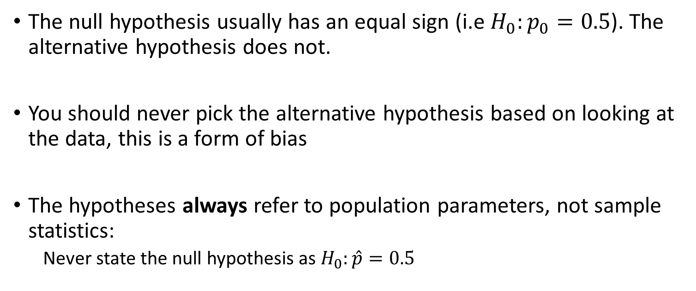
Technical Points of Significance Tests
The null hypothesis usually has an equal sign (i.e $H_{0}:p_{0}=0.5$). The alternative hypothesis does not.
You should never pick the alternative hypothesis based on looking at the data, this is a form of bias
The hypotheses always refer to population parameters, not sample statistics:
Never state the null hypothesis as $H_{0}:\hat{p}=0.5$

Slide 10
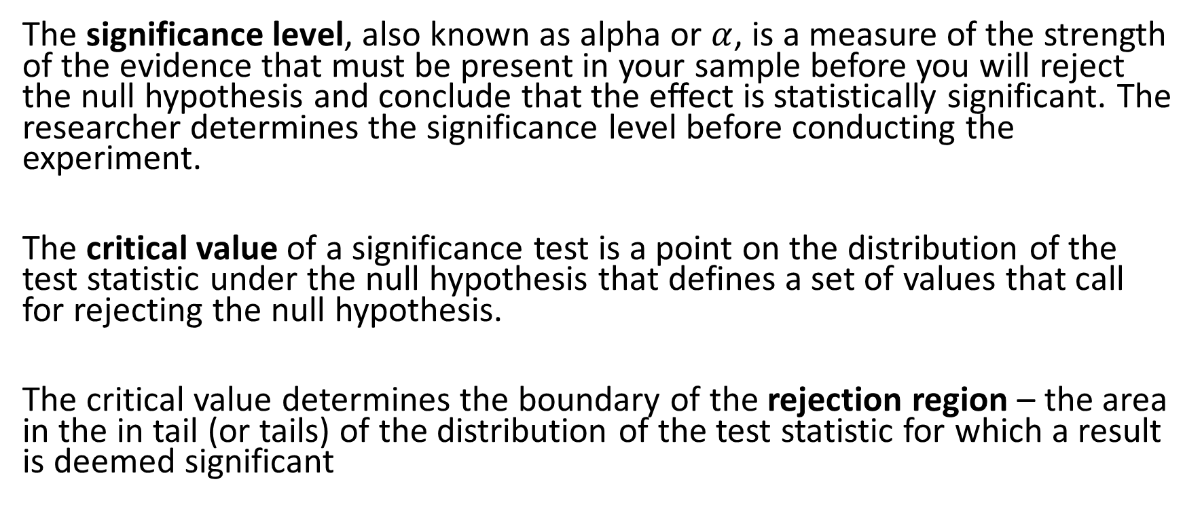

Significance Level $α$ and Critical Value
The significance level, also known as alpha or $α$, is a measure of the strength of the evidence that must be present in your sample before you will reject the null hypothesis and conclude that the effect is statistically significant. The researcher determines the significance level before conducting the experiment.
The critical value of a significance test is a point on the distribution of the test statistic under the null hypothesis that defines a set of values that call for rejecting the null hypothesis.
The critical value determines the boundary of the rejection region – the area in the in tail (or tails) of the distribution of the test statistic for which a result is deemed significant

Slide 11
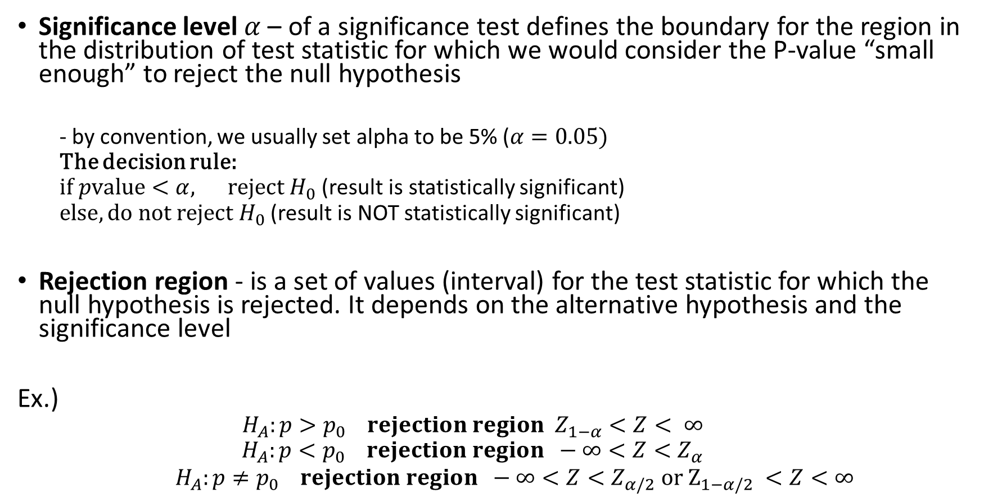
The Decision Rule
Significance level $α$– of a significance test defines the boundary for the region in the distribution of test statistic for which we would consider the P-value “small enough” to reject the null hypothesis
- by convention, we usually set alpha to be 5% ($α=0.05)$
The decision rule:
$if pvalue<α, reject H_{0}$ (result is statistically significant)
$else, do not reject H_{0}$ (result is NOT statistically significant)
Rejection region - is a set of values (interval) for the test statistic for which the null hypothesis is rejected. It depends on the alternative hypothesis and the significance level
Ex.)
$$H_{A}:p>p_{0} rejection region Z_{1−α}<Z< ∞$$
$$H_{A}:p<p_{0} rejection region −∞<Z<Z_{α}$$
$H_{A}:p≠p_{0} rejection region −∞<Z<Z_{α/2} or Z_{1−α/2} <Z<∞$

Slide 12
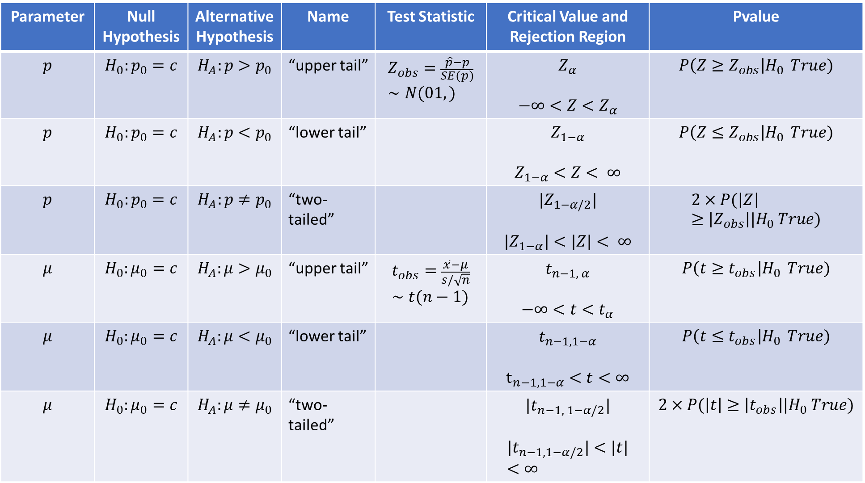
Parameter | Null Hypothesis | Alternative Hypothesis | Name | Test Statistic | Critical Value and Rejection Region | Pvalue
$$p$$ | $$H_{0}:p_{0}=c$$ | $$H_{A}:p>p_{0}$$ | “upper tail” | $$Z_{obs}=\frac{\hat{p}−p}{SE(p)}∼N(01,)$$ | $$Z_{α}$$ $$−∞<Z<Z_{α}$$ | $$P\left(Z≥Z_{obs}\right|H_{0 } True)$$
$$p$$ | $$H_{0}:p_{0}=c$$ | $$H_{A}:p<p_{0}$$ | “lower tail” |  | $$Z_{1−α}$$ $$Z_{1−α}<Z< ∞$$ | $$P\left(Z≤Z_{obs}\right|H_{0 } True)$$
$$p$$ | $$H_{0}:p_{0}=c$$ | $$H_{A}:p≠p_{0}$$ | “two-tailed” |  | $$|Z_{1−α/2}|$$ $${|Z}_{1−α}|<|Z|< ∞$$ | $$2×P(\left|Z\right|≥\left|Z_{obs}\right||H_{0} True)$$
$$μ$$ | $$H_{0}:μ_{0}=c$$ | $$H_{A}:μ>μ_{0}$$ | “upper tail” | $$t_{obs}=\frac{\overline{x}−μ}{s/\sqrt{n}}∼t(n−1)$$ | $$t_{n−1, α}$$ $$−∞<t<t_{α}$$ | $$P\left(t≥t_{obs}\right|H_{0 } True)$$
$$μ$$ | $$H_{0}:μ_{0}=c$$ | $$H_{A}:μ<μ_{0}$$ | “lower tail” |  | $$t_{n−1, 1−α}$$ $$t_{n−1, 1−α}<t<∞$$ | $$P\left(t≤t_{obs}\right|H_{0 } True)$$
$$μ$$ | $$H_{0}:μ_{0}=c$$ | $$H_{A}:μ≠μ_{0}$$ | “two-tailed” |  | $${|t}_{n−1, 1−α/2}|$$ $$|t_{n−1, 1−α/2}|<|t|<∞$$ | $$2×P(\left|t\right|≥\left|t_{obs}\right||H_{0} True)$$

Slide 13
Example 1:
Does taking garlic supplements repel ticks? A study published in the Journal of the American Medical Association used a cross-over experimental design to determine if daily consumption of garlic would reduce tick bites. A total of 66 Swedish military personnel took 1200mg of garlic daily during one period, and a placebo during the other period. 37 subjects reported fewer tick bites during the period they took garlic supplements. Is there evidence that more than 50% of Swedish soldiers experienced fewer tick bites while taking the garlic supplement?
Conduct a significance test at the 5% significance level and report your conclusion.

Slide 14
Example 2:
In the city of Las Vegas, by law cars are required to stop for pedestrians trying to cross the street. In practice many drivers do not stop. A study conducted by the University of Nevada, Las Vegas conducted trials by having pedestrians wait at the curb of a midblock crosswalk and observe whether the next car approaching would stop. Out of a total of 126 of such trials, in 76 trials the first car approaching stopped for the pedestrian. Is there evidence that fewer than 75% of drivers actually stop?
Conduct a significance test at the 5% significance level and report your conclusion.

Slide 15
Example 3:
A study investigated if dogs could be trained to detect whether a person has lung cancer or breast cancer by smelling the subject's breath. The researchers trained five ordinary household dogs to distinguish, by scent alone, exhaled breath samples of 55 lung and 31 breast cancer patients from those of 83 healthy controls. Once trained, the dogs’ ability to distinguish cancer patients from controls was tested using breath samples from 119 subjects not previously encountered (dogs and handlers were blinded from the treatments to avoid bias). The dogs correctly distinguished between cancer patients and controls for 101 out of 119 subjects. Is there any evidence that the probability of the dogs correctly selecting patients differs from random guessing?
Conduct a significance test at the 1% significance level and report your conclusion.

Slide 16
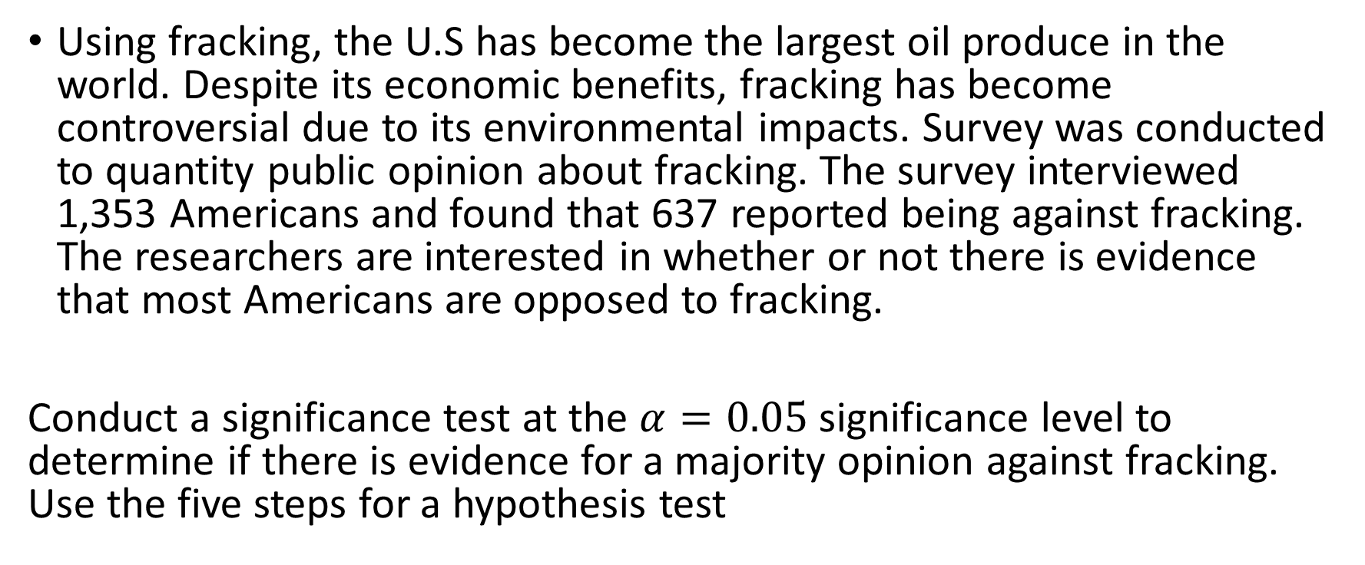
Example 4
Using fracking, the U.S has become the largest oil produce in the world. Despite its economic benefits, fracking has become controversial due to its environmental impacts. Survey was conducted to quantity public opinion about fracking. The survey interviewed 1,353 Americans and found that 637 reported being against fracking. The researchers are interested in whether or not there is evidence that most Americans are opposed to fracking.
Conduct a significance test at the $α=0.05$significance level to determine if there is evidence for a majority opinion against fracking. Use the five steps for a hypothesis test

Slide 17
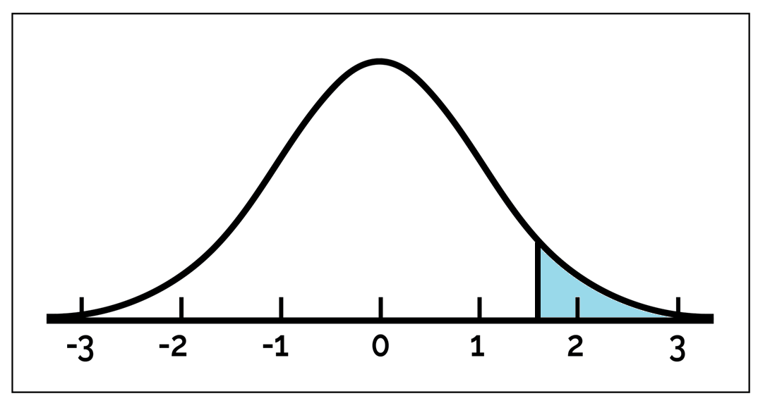

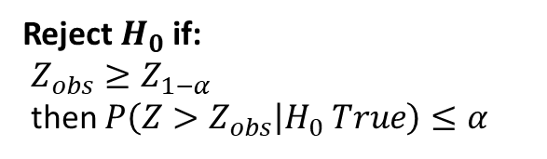



$$α=P\left(Z≥Z_{1−α}\right)$$
Rejection Region = $[Z_{1−α}, ∞)$
Reject $H_{0}$ if:
$Z_{obs}≥Z_{1−α}$
then $P\left(Z>Z_{obs} | H_{0} True\right)≤α$
Do Not Reject
$$H_{0}$$
$$Z_{1−α}$$

Slide 18
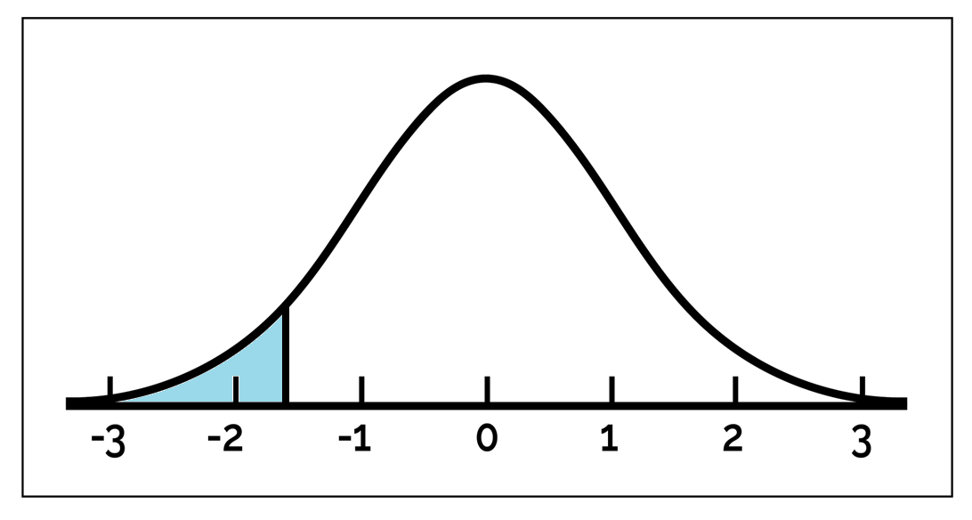

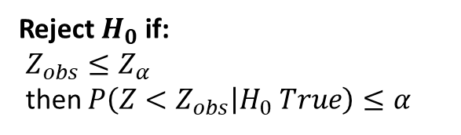


$$α=P\left(Z≤Z_{α}\right)$$
Rejection Region = $(−∞, Z_{α}]$
Reject $H_{0}$ if:
$Z_{obs}≤Z_{α}$
then $P\left(Z<Z_{obs} | H_{0} True\right)≤α$
Do Not Reject
$$H_{0}$$
$$Z_{α}$$

Slide 19
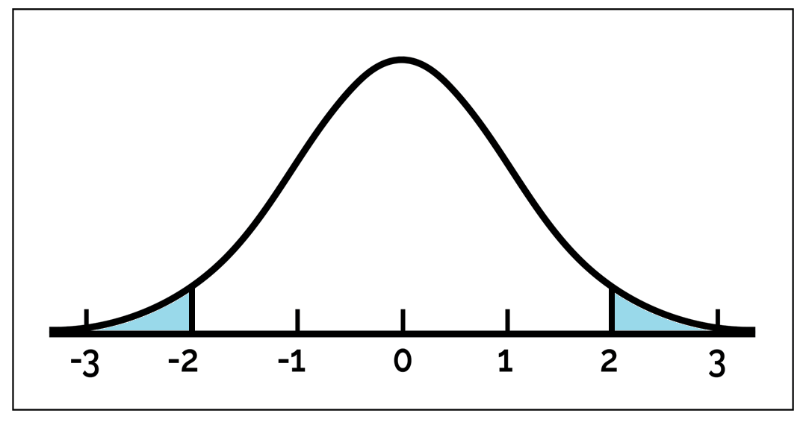
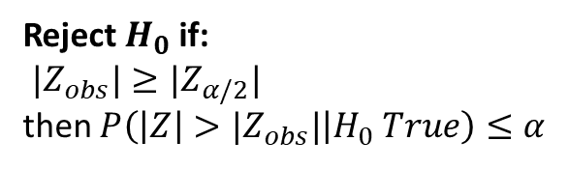





$$α=P\left(|Z|≥|Z_{α/2}|\right)$$
Rejection Region = $(−∞, Z_{α/2}]$ and $[Z_{1−α/2}, ∞)$
Reject $H_{0}$ if:
${|Z}_{obs}|≥|Z_{α/2}|$
then $P\left(\left|Z\right|>|Z_{obs}| | H_{0} True\right)≤α$
Do Not Reject
$$H_{0}$$
$$Z_{α/2}$$
$$Z_{1−α/2}$$

Slide 20
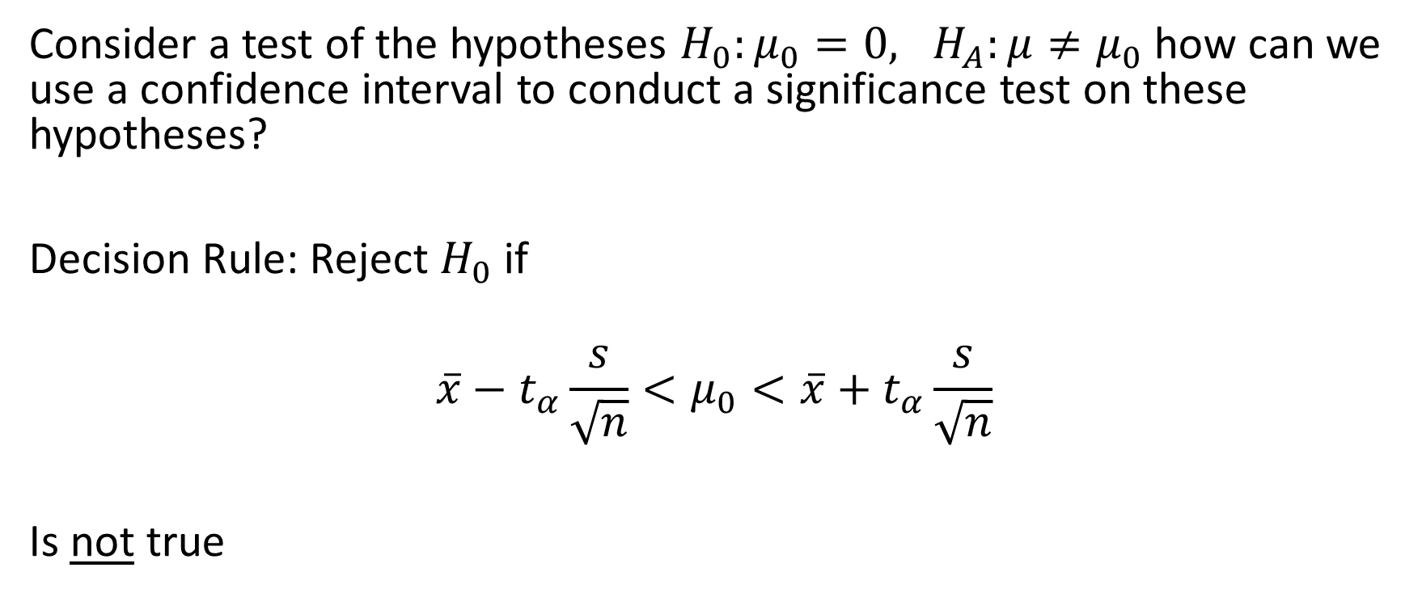
Relationship between significance tests and confidence intervals
Consider a test of the hypotheses $H_{0}:μ_{0}=0, H_{A}:μ≠μ_{0}$ how can we use a confidence interval to conduct a significance test on these hypotheses?
Decision Rule: Reject $H_{0}$ if
$$\overline{x}−t_{α}\frac{s}{\sqrt{n}}<μ_{0}<\overline{x}+t_{α}\frac{s}{\sqrt{n}}$$
Is not true

Slide 21
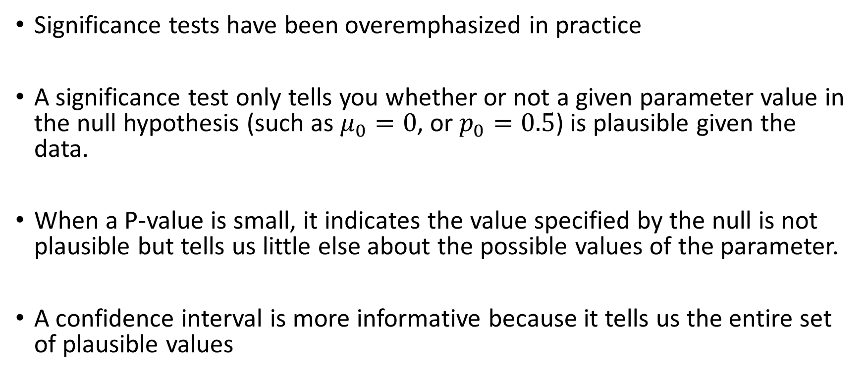
Significance tests are less useful than confidence intervals
Significance tests have been overemphasized in practice
A significance test only tells you whether or not a given parameter value in the null hypothesis (such as $μ_{0}=0$, or $p_{0}=0.5$) is plausible given the data.
When a P-value is small, it indicates the value specified by the null is not plausible but tells us little else about the possible values of the parameter.
A confidence interval is more informative because it tells us the entire set of plausible values

